Slide 1
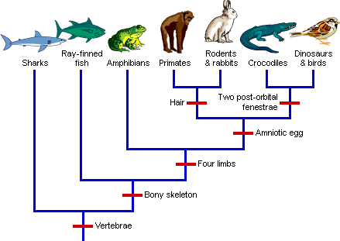
Evolutionary Trends
BIO 101
By
Alafia, A.O. (Ph.D)

Slide 2
Evolutionary trend
Evolutionary biology is a subfield of biology concerned with the study of the evolutionary processes that produced the diversity of life on Earth.
Evolutionary biologists study the descent of species, and the origin of new species.
Evolution is a scientific theory proposed by Charles Darwin. It occurs at the population level, It is made possible by genetic variations
EVIDENCES THAT SPECIES EVOLVE COMES FROM THREE LINES OF INVESTIGATION
Relationship were discerned among major groups of animals (Comparative anatomy)
Explorers discovered difference in the world distribution of species (Biogeography)
Geologist discovered apparent sequence of changing fossils in distinct layers of the earth

Slide 3
History of Life on Earth
BILLIONS OF YEARS AGO EXPLOSION OF DYING STARS RIPPED THROUGH OUR GALAXY AND LEFT BEHIND A DENSE CLOUD OF DUST AND GAS
AS THE CLOUD COOLED
There are scientific evidence that earth and the other planets of the solar system formed about 4.6 billion years ago.
Evidences have shown that conditions on early Earth made the origin of life possible e.g is the fossils of microorganisms that are about 3.5 billion years old.
There are approximately two million species of animals and plants living today,
How did this diversity of life come to exist?

Slide 4
The Voyage of the Beagle
Charles Darwin (1809-1882)
He went on a voyage from England with the aim of drawing a chart of the South American coastline
But while on the journey, he observed and collected samples of South American plants and animals.
He noted their adaptive characteristics to their environment.
They had a stop at the Galapagos , a group of Islands located close to the equator about 900km west of South America.
There he observed some unusual animals.
e.g Birds with different beak sizes and different species, some were unique to individual islands while others lives on two or more adjacent island

Slide 5
Darwin and the theory of Evolution
Darwin developed two main ideas from four observations
Observations
1: Members of a population vary greatly in their traits
2; Traits are inherited from parents to offspring
3: All species are capable of producing more offspring than their environment can support
4: Owing to lack of food or other resources, many of these offspring do not survive
Ideas
That descent with modification explains life’s unity and diversity
That natural selection brings about the match between organisms and their environment
Notes:
Charles Darwin was a naturalist who devoted his time to collecting plants and animals . He was opportuned to go a journey for map-making survey on HMS Beagle, the voyage which lasted for almost five years availed him the opportunity to explore the flora and fauna in different parts of the world. In the Pacific Ocean, he was at the Galapagos Island.

Slide 6
Darwin and the theory of Evolution
Darwin conclusion therefore means that Animals and Plants have arisen by a process of slow and gradual change over successive generations.
This gradual change is brought about by NATURAL SELECTION
We can therefore infer that
Individuals whose inherited traits give them a higher probability of surviving and reproducing in a given environment tend to leave more offspring than other individuals
This unequal ability of individuals to survive and reproduce will lead to accumulation of favorable traits in the population over generations

Slide 7
Fossils
Fossils are the remains of animals and plants that died a very long time ago and became preserved in rocks. These remains are our ‘window to the past’ .
In general, it takes at least 10,000 years but usually millions, for fossils to form.
Fossil evidences shows that past organisms were very different from those now alive.
.

Slide 8
LEVELS OF EVOLUTION
There are two levels of evolution
Microevolution
Macroevolution
Microevolution- changes in allele frequencies in a population over generations, it occurs at the genetic level. Small scale changes.
What causes allele frequency to change
Natural selection
Genetic drift – chance events that alters allele frequencies
Gene flow – the transfer of alleles between populations.
Only natural selection can cause ADAPTIVE RADIATION

Slide 9
LEVELS OF EVOLUTION
Macroevolution-Larger changes, such as when a new species is formed. It includes the idea that all life forms is connected and can be traced back to one common ancestor.
Macroevolution is cumulative microevolution
The sweeping changes in life on Earth revealed by fossils illustrates MACROEVOLUTION

Slide 10
The process of evolution can be summarized in three sentences:
Genes mutate.
Individuals are selected.
Populations evolve.
Note: individuals do not evolve but populations evolve e.g Biston betularia (English moth), Geospiza fortis.

Slide 11
Evolution
Evolution can be viewed in two related but different ways
As a pattern
As a process
One way to assess whether natural selection or other factors are causing evolution at a particular locus is to determine what the genetic makeup of a population would be if it were not evolving at that locus, and then compare with the real scenario. If there are no difference we can conclude that the real population is not evolving.

Slide 12
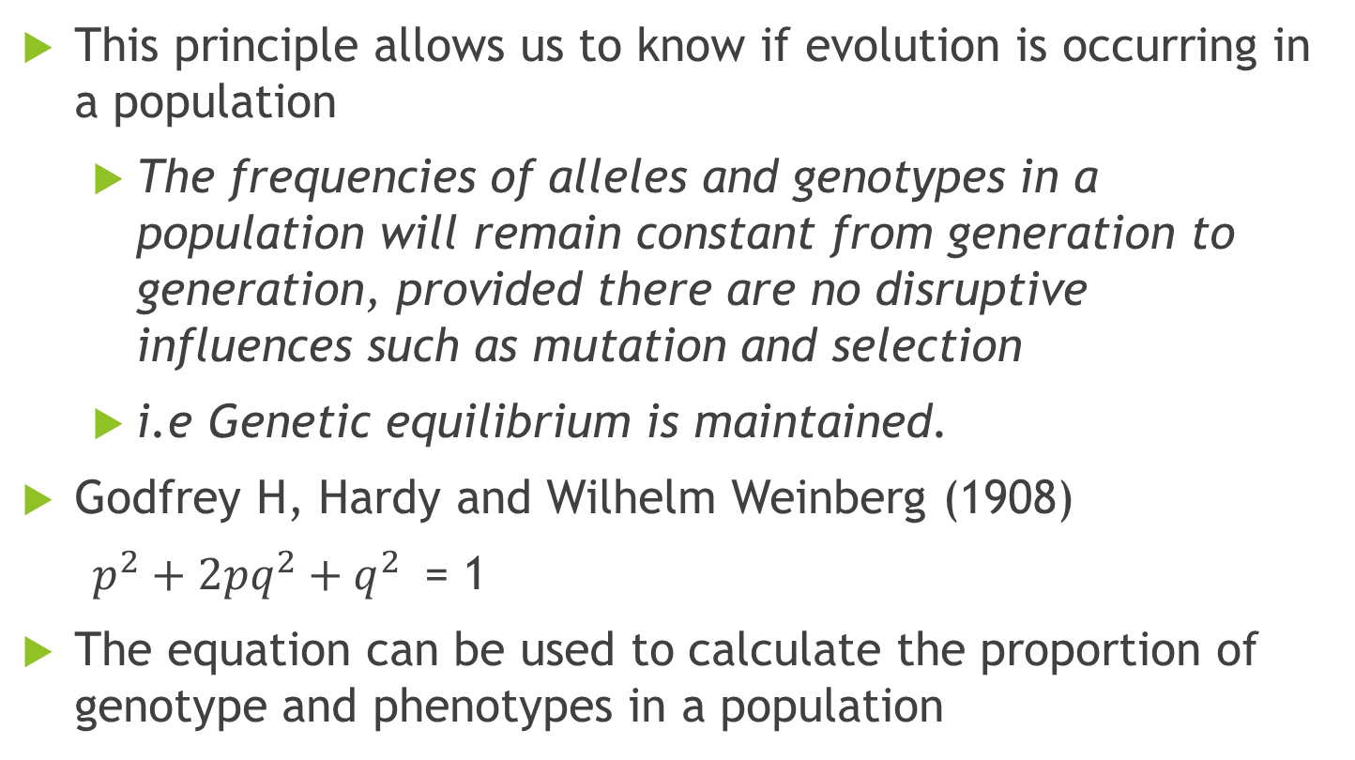
Hardy-Weinberg EQUILIBRUM
This principle allows us to know if evolution is occurring in a population
The frequencies of alleles and genotypes in a population will remain constant from generation to generation, provided there are no disruptive influences such as mutation and selection
i.e Genetic equilibrium is maintained.
Godfrey H, Hardy and Wilhelm Weinberg (1908)
$p^{2}+{2pq}^{2}+q^{2 }$= 1
The equation can be used to calculate the proportion of genotype and phenotypes in a population

Slide 13
The Hardy-Weinberg Theorem
Assumptions
Size must be extremely large (frequency will not change by chance)
Random Mating
No Migration / No gene flow
No Mutation
No natural selection
If they are met, they EVOLUTION will not occur.

Slide 14
FACTORS THAT BRING ABOUT EVOLUTION
Violations of the conditions in the Hardy-Weinberg equilibrium can bring about EVOLUTION
New mutations brings about alteration in allele frequencies , but mutations are rare.
Non random mating can affect frequency of homozygous and heterozygous genotypes but these may have no effect on allele frequencies in the gene pool.
The three mechanisms that alter allele frequencies directly and cause most evolutionary change are natural selection, genetic drift and gene flow.
These three mechanisms cause decrease in genetic variation.

Slide 15
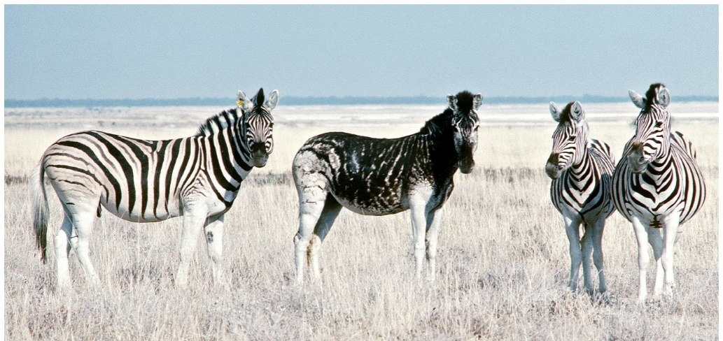
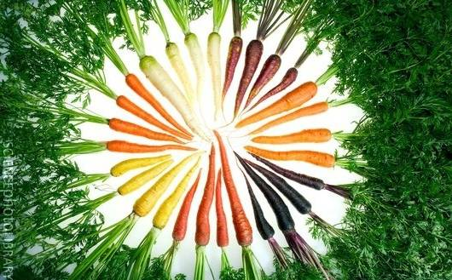
GENETIC VARIATION
Variation is the range of differences that there are between individual organisms.
Variation in traits has a heritable basis
Variation can be within species
(Think of all the differences between individual humans)
These are different varieties of the same species Or between species:

Slide 16
Natural Selection is defined as differential reproductive success of pre- existing classes of genetic variants in the gene pool.
This is the process by which biological evolutionary changes take place. It is based on the following concepts
Individuals in a population have different traits which can be inherited
These individuals produce more young than the environment can support
The individuals best suited to their environment will leave more offspring's, resulting in a change in the genetic make up of that population.
The most common action of natural selection is to remove unfit variants as they arise via mutation. In other words, natural selection usually prevents new alleles from increasing in frequency.

Slide 17
Natural selection can maintain or deplete genetic variation depending on how it acts
Mechanisms that increase genetic variation are mutation, recombination and gene flow.

Slide 18
Example
Fruit fly (Drosophila melanogaster) has an allele that confers resistance to several insecticides. The allele has a frequency of 0% in flies collected in the wild in early 1930’s , before the introduction of DDT. However, strains of flies collected after 1960 , the allele frequency is 37%.
This type of evolution is called ADAPTIVE EVOLUTION

Slide 19
GENETIC DRIFT
Chance events can cause allele frequencies to fluctuate unpredictably from one generation to the next, especially in small populations .
This process is called GENETIC DRIFT.
Certain circumstances can result in genetic drift having a significant impact on a population. Two examples are the founder effect and the bottleneck effect.

Slide 20
The founder effect
Founder effect occur when a few individuals become isolated from a larger population, this smaller group may establish a new population whose gene pool may establish a new population whose gene pool differ from the source population.
This can occur when storm indiscriminately transports some individuals (and their alleles ) but not others, from the source population.
Now, lets look at some examples

Slide 21
British colonist founded a settlement (Tristan de Cunha). One of the colonists carried a recessive allele for retinitis pigmentosa, a progressive form of blindness that afflicts homozygous individuals. Of the 240 descendants of the founders, 4 had retinitis pigmentosa.
The frequency of the allele that causes this disease is ten times higher on Tristan de Cunha than in the population in which the founders came.

Slide 22
The bottleneck effect
A sudden change in the environment e.g. drought , fire or flood may drastically reduce the size of a population.
A severe drop in population size can cause BOTTLENECK EFFECT.
By chance, certain alleles may be overrepresented , underrepresented or totally absent.
Even if a population that has passed through a bottleneck ultimately recovers in size, it may have low levels of genetic variation for a long period of time.

Slide 23
Summary of effects of genetic drift
Genetic drift is significant in small populations
It can cause allele frequencies to change at random over time
It can lead to a loss of genetic variation within populations
It can cause harmful alleles to become fixed

Slide 24
GENE FLOW
This is the transfer of alleles into or out of a population due to the movement of fertile individuals or their gametes

Slide 25
MECHANISM OF MACROEVOLUTION
Speciation -- Increasing Biological Diversity
Extinction – reducing Biological Diversity
Speciation is the process of a single species becoming two or more species.

Slide 26
ORIGIN OF SPECIES: Mode of Speciation
A species is a group of populations whose members have the potential to interbreed in nature and produce viable, fertile offspring
There are two types of speciation: allopatric and sympatric speciation.
The two differ in geographical distribution of the populations in question.
Allopatric speciation is the most common form of speciation. It occurs when a population is split into two (or more) geographically isolated subdivisions that organisms cannot bridge. Eventually, the two populations' gene pools change independently until they could not interbreed even if they were brought back together. In other words, they have speciated.
.

Slide 27
ORIGIN OF SPECIES
Sympatric speciation occurs when two subpopulations become reproductively isolated without first becoming geographically isolated.
Insects that live on a single host plant provide a model for sympatric speciation. If a group of insects switched host plants they would not breed with other members of their species still living on their former host plant. The two subpopulations could diverge and speciate.
. Agricultural records show that a strain of the apple maggot fly Rhagolettis pomenella began infesting apples in the 1860's. Formerly it had only infested hawthorn fruit.

Slide 28
ORIGIN OF SPECIES
Speciation has been observed. In the plant genus Tragopogon, two new species have evolved within the past 50-60 years. They are T. mirus and T. miscellus. The new species were formed when one diploid species fertilized a different diploid species and produced a tetraploid offspring. This tetraploid offspring could not fertilize or be fertilized by either of its two parent species types. It is reproductively isolated, the definition of a species.

Slide 29
Factors that promote sympatric speciation
1. Polyploidy
2. Habitat differentiation
3. Sexual selection

Slide 30
Extinction
Extinction is the ultimate fate of all species.
The reasons for extinction are numerous.
A species can be competitively excluded by a closely related species, the habitat a species lives in can disappear and/or the organisms that the species exploits could come up with an unbeatable defense.

Slide 31
HISTORY OF EARTH
Geologic records has told us that Earths time can be divided into three Eons,
The first two Eons – the Archean and Protoezoic together lasted approximately 4 billion years. The Phanerozoic eon, the last half billion years ago encompasses most of the time that animals have existed on earth.
It is divided into three Eras : the Paleozoic, Mesozoic and Cenozoic.
Each era represents a distinct age in history of Earth and its life.
The first evidence of life dates back to 3.5 billion yaers ago and the record comes from fossilized stromatolites, formed by Prokayotes

Slide 32
Evolutionary trends in ANIMALS
1. Trends in Symmetry
2. Trends in Digestive Tracts
3. Trends in Body Cavities
4. Trends in Cephalization
5. Trends in Segmentation
6. Trends in Skeletal modification

Slide 33
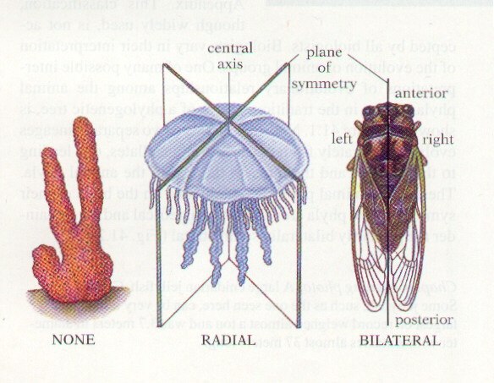
EVOLTUTIONARY TREND IN SYMMETRY
Asymmetry ( No Symmetry )
Radial Symmetry
Bilateral Symmetry

Slide 34
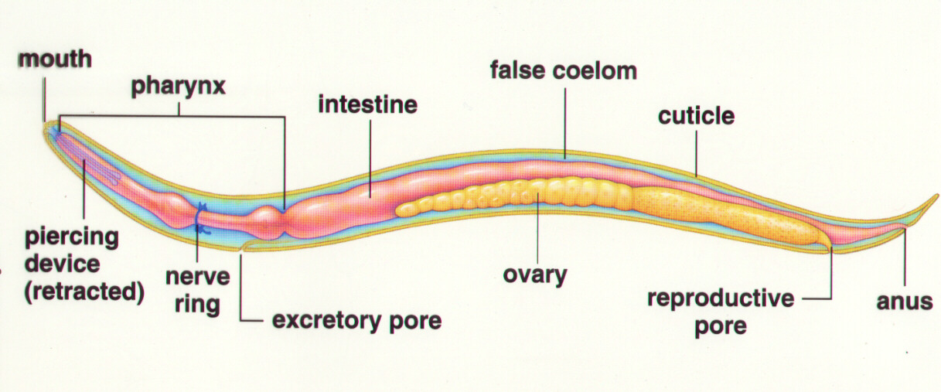
Digestive system complete
Incomplete
Complete

Slide 35
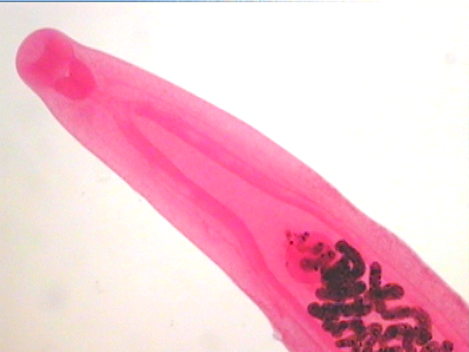
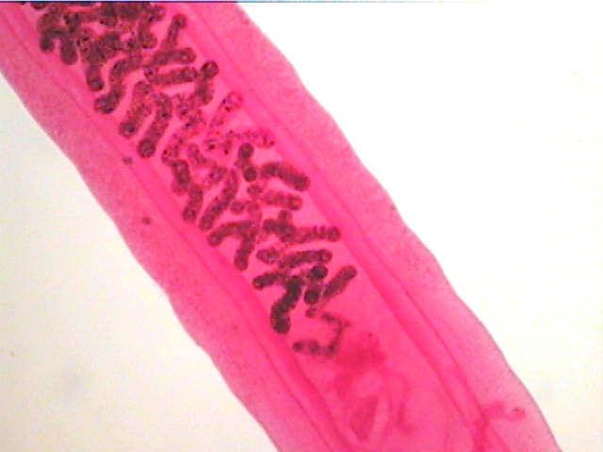
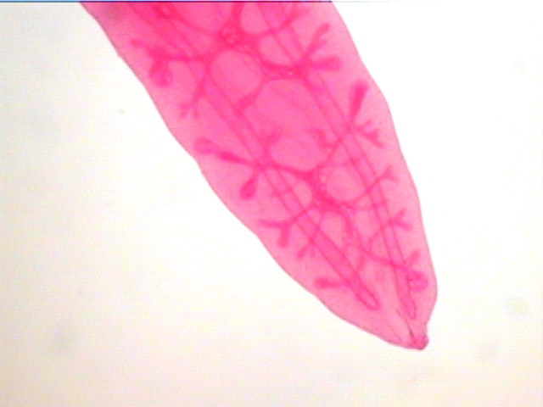
Incomplete

Slide 36
Evolutionary Trend in Body cavity
Acoelom (No Coelom )e.g platyhelminthes Flatworms
Pseudocoelom (False Body Cavity) e.g Round worm (Ascaris)
Coelom (True Coelom) e.g Earthworm

Slide 37
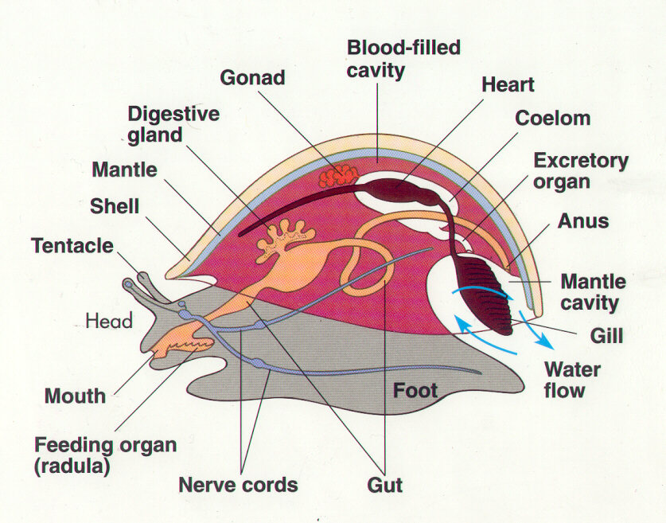
Advantages of coelom and psuedocoelom
The reproductive and digestive organs can evolve more complex shapes and functions.
The gut tube and other organs are cushioned and thus better protected.
Can act as hydroskeleton providing support and rigidity for the soft animal.
The activities of the suspended gut can take place undisturbed by the activity of the animal’s outer

Slide 38
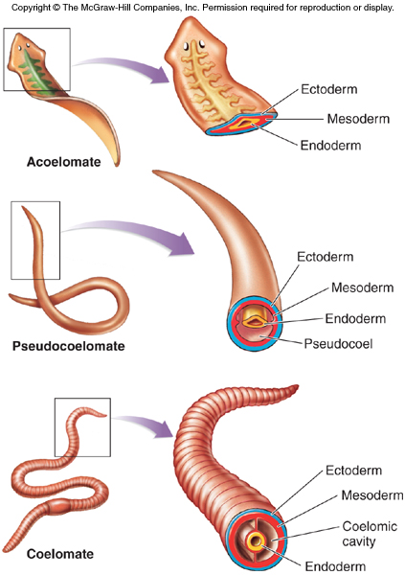

Slide 39
EVOLUTIONARY TREND IN CEPHALIZATION
Cephalization is considered an evolutionary trend, whereby nervous tissue, over many generations, becomes concentrated toward one end of an organism.
This process eventually produces a head region with sensory organs.

Slide 40
Protostomes or “First Mouth Animals”
During their embryonic development the mouth forms first and the anus second.
Deuterostomes: “Second Mouth Animals”
During their embryonic development the anus forms first and the mouth second.

Slide 41
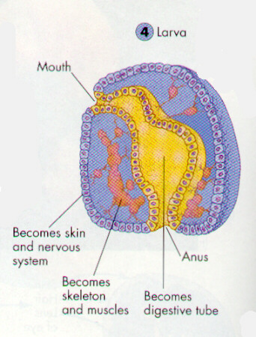
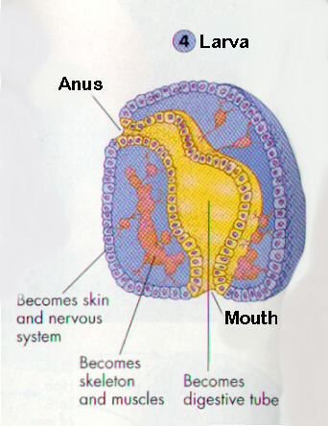
Larva
Deuterostome
Protostome

Slide 42
Evolutionary Trend in Segmentation
Segmentation in biology refers to the division of some animal and plant body plans into a series of repetitive segments.
i. this similar repeated units permit larger organisms
ii. in annelids (segmented worms), segments are similar
-- form fluid filled compartments that can be stretched or compressed separately-- worm locomotion
iii. segmentation permits specialization of different segments

Slide 43
Evolutionary Trend in SKELETAL MODIFICATION
TREND AMONG PRIMATE
FROM LEGGED GAITS TO SPECIALIZED MODE OF LOCOMOTION E.G BIPEDALISM (TWO LEGGED GAIT)
CHANGES IN THE SHOULDERS, BACKBONE, PELVIC GIRDLE, LEGS AND
CHANGE IN DENTITION
MODIFICATION OF HANDS LEADING TO INCREASED MANIPULATIVE SKILLS
LESS RELIANCE ON SENSE OF SMELL, MORE RELIANCE ON ENHANCED DAYTIME VISION
FROM SPECIALIZED TO OMNVOROUS EATING HABITS
BRAIN EXPANSION AND REORGANIZATION.- THIS TREND BEGAN WITHAMONG MAMMALS GENERALLY BUT ACCELERATED DURING HOMONID EVOLUTION

Slide 44
TREND IN BEHAIVOURAL MODIFICATION
LONGER LIFE SPAN
LONGER PERIODS BETWEEN PREGNANCY
SINGLE BIRTHS RATHER THAN LITTERS
EXTENDED PERIOD OF INFANCY DEPENDENCY

